Slide 1

How to make switchport as a Trunk, Access or Desirable port in VLAN
Prepared by: Fahad Burhan Ahmad

Slide 2
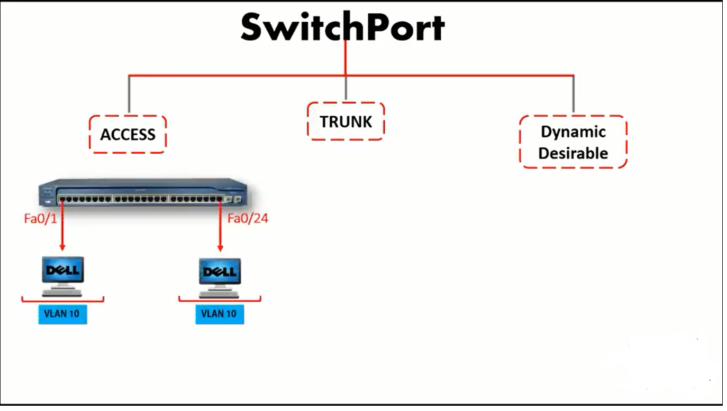
Access Port just transfer the data to specific VLAN

Slide 3
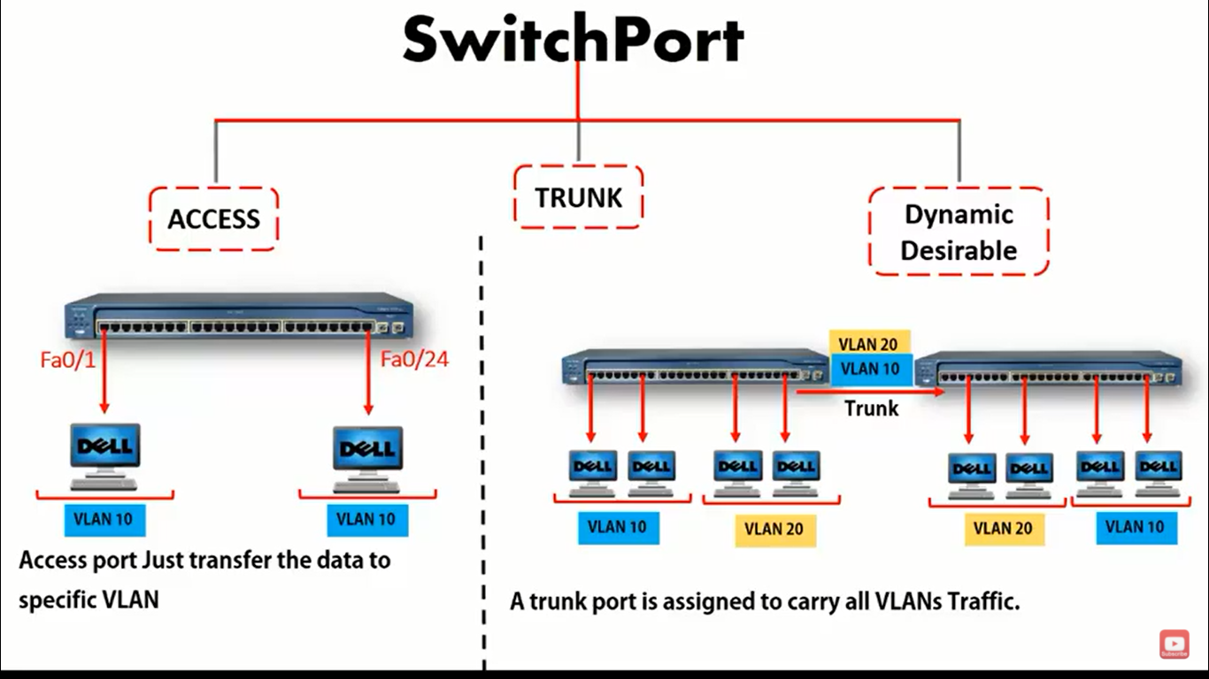

Slide 4
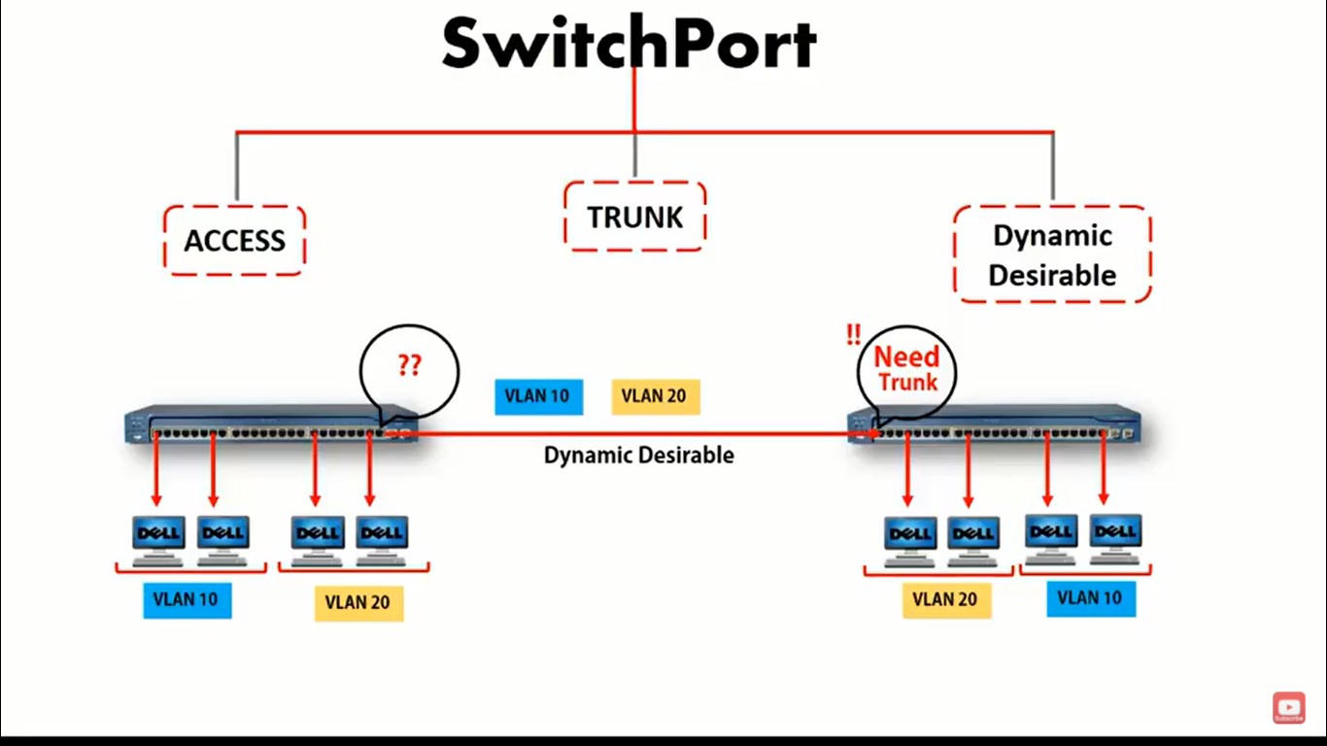

Slide 5
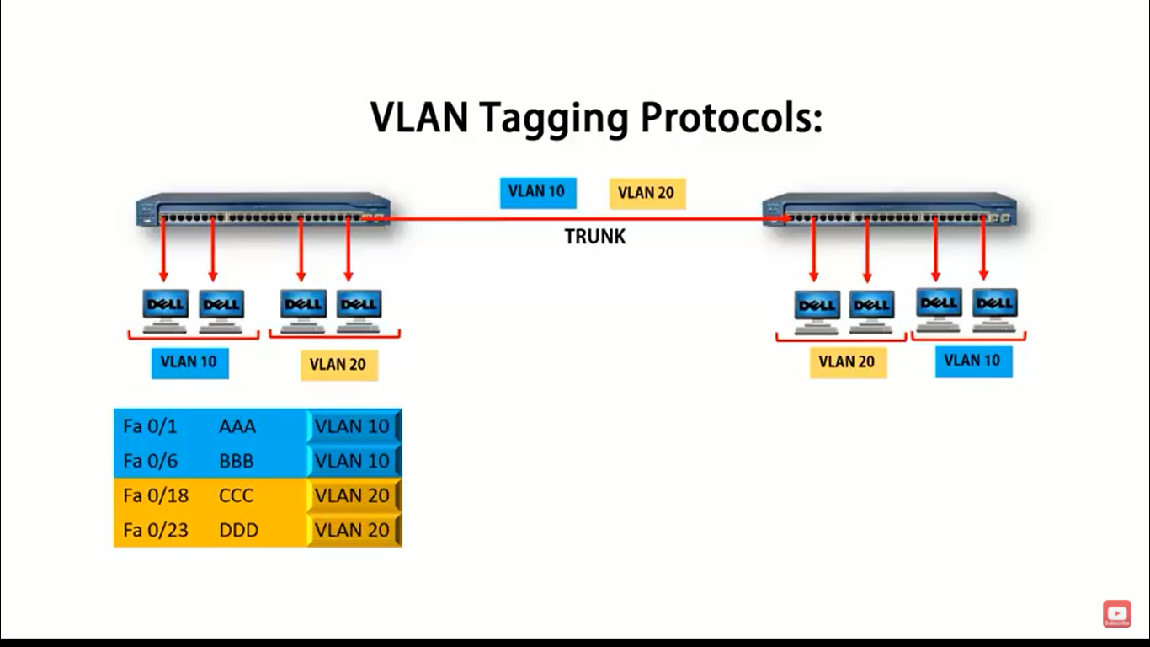

Slide 6
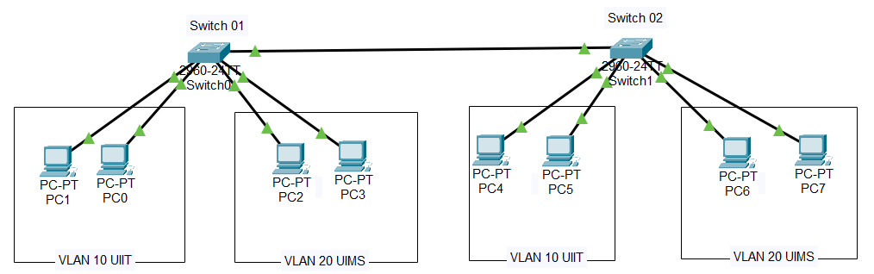
VLAN Port membership

Slide 7
VLAN 10 UIIT Configuration Commands (Single Port)
Switch(config)#vlan 10
Switch(config-vlan)#int fa 0/1
Switch(config-if)#switchport mode access
Switch(config-if)#switchport access vlan 10
Switch(config-if)#exit
Switch(config)#exit
Switch#show run

Slide 8
VLAN 20 UIMS Configuration Commands (multiple Port)
Switch>enable
Switch#conf ter
Switch(config)#vlan 20
Switch(config-vlan)#int range fa 0/22-23
Switch(config-if-range)#switchport mode access
Switch(config-if-range)#switchport access vlan 20
Switch(config-if-range)#exit
Switch(config)#exit
Switch#show run or show vlan

Slide 9
creating Trunk Port
To make port trunk
Switch>enable
Switch#conf ter
Switch(config)#int fa 0/24
Switch(config-if)#switchport mode trunk
Switch#show vlan
Switch#show int trunk

Slide 10
Delete VLAN
To delete interfaces manually from VLAN
Switch(config)#interface range fastEthernet 0/1-10
Switch(config-if-range)#no switchport access vlan 10
Switch(config-if-range)#exit

Slide 11
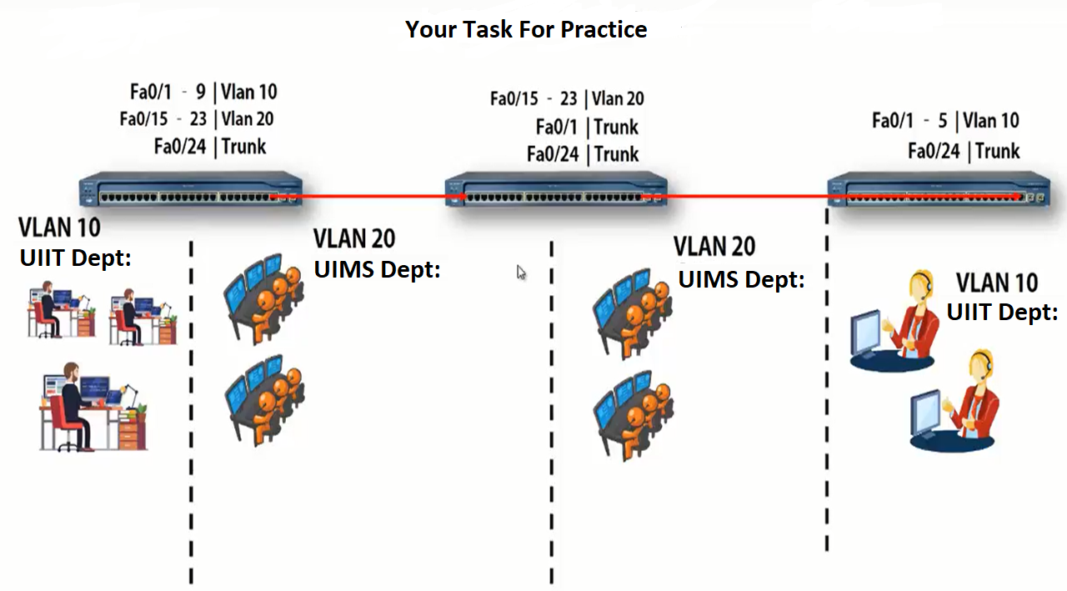

Slide 12
Important Note
To get traffic of all VLAN’s *
Create all vlans same like you created in other switches
Vlan 10
Vlan 20
Vlan 30

Slide 13



Thanks for Watching
Repeat the steps until you learn

